Slide 1


RN to BSN and RN to MSN Bridge - Clinical Information Session
6/1/2025

Slide 2

What Are Clinical Field Experiences?
A combination of direct and/or indirect hours through which professional practice and simulation experiences are supervised, verified, evaluated, and documented.
All learners in entry-level professional nursing programs will engage in direct patient care learning activities in all four spheres of care and across the life span (Wellness/ Disease Prevention, Regenerative/Restorative Care, Hospice Palliative Care and Chronic Disease Management) and provide clear evidence of student competency achievement (AACN, 2021, P 19)

Slide 3
Clinical Field Experience Courses
E224 Global & Population Health
  Students will be required to complete 35 direct patient care hours with an appropriate preceptor focused on one or more spheres of care.
L225 Professional Practice Experiences for the Health of Diverse Populations
  Students desiring to apply for the California Public Health Nurse (PHN) certificate after graduation will be required to complete 90 direct patient care hours with an appropriate preceptor focused on one or more spheres of care.
The student should experience nursing strategies used to support and maintain the health of populations within the community focusing one or more of the AACN spheres of care:
  Wellness/disease prevention
  Regenerative/restorative care
  Chronic disease management
  Palliative/hospice care

Slide 4
E224 Competencies L225 Competencies
Course Competencies
Therapeutic Interventions
Competency 738.7.1: Distinguish Foundations in Population Health and the Nurse's Role
The learner distinguishes between global, public, and population health for improved health outcomes.
Competency 738.7.2: Identify Social Determinants of Health
The learner identifies social determinants of health (SDOH) and interventions for equitable healthcare improvements.
Competency 738.7.3: Identify Epidemiological Data Sources
The learner identifies epidemiological data sources that inform population health interventions.
Competency 738.7.4: Identify Global Health Trends
The learner identifies the effect of global health trends on healthcare capacity that inform service modification decisions in healthcare.
Competency 738.7.5: Evaluate Population Health Interventions
The learner evaluates population health solutions for environmental health effects.
Competency 738.8.1 Analyze Genetic and Genomic Influences and Risks
The learner analyzes genetic and genomic influences and risks to plan patient education that recognizes individual attitudes and values.
Competency 738.8.2 Explain Palliative Care Interventions
The learner explains interprofessional interventions that alleviate suffering, improve quality of life, and empower patients and families who have received life-limiting diagnoses.
Competency 738.8.3 Create a Professional Development Plan
The learner creates a personal five-year professional development plan that includes professional certification or specialized education that facilitates lifelong learning.

Slide 5
Site Requirements
• Sites must be appropriate outpatient, community-focused settings.
  Procedural sites are acceptable only if students are placed in post-procedural areas that provide supportive nursing care to patients and families.
  In-patient, acute care, hospital settings are not appropriate.
The site must agree to engage in an affiliation agreement with WGU and accept the student.
There must have a BSN or higher (MSN, NP, DNP preferred) RN who provides direct patient care to facilitate the field experiences.
You must be able to discuss and explain the experiences for one or more spheres of care appropriate for the course.
For questions on appropriateness of specific sites or field experience hours/activities please contact:
E224 – E224PopHealth@wgu.edu L225 – L225PopPracticeExp@wgu.edu
Therapeutic Interventions

Slide 6
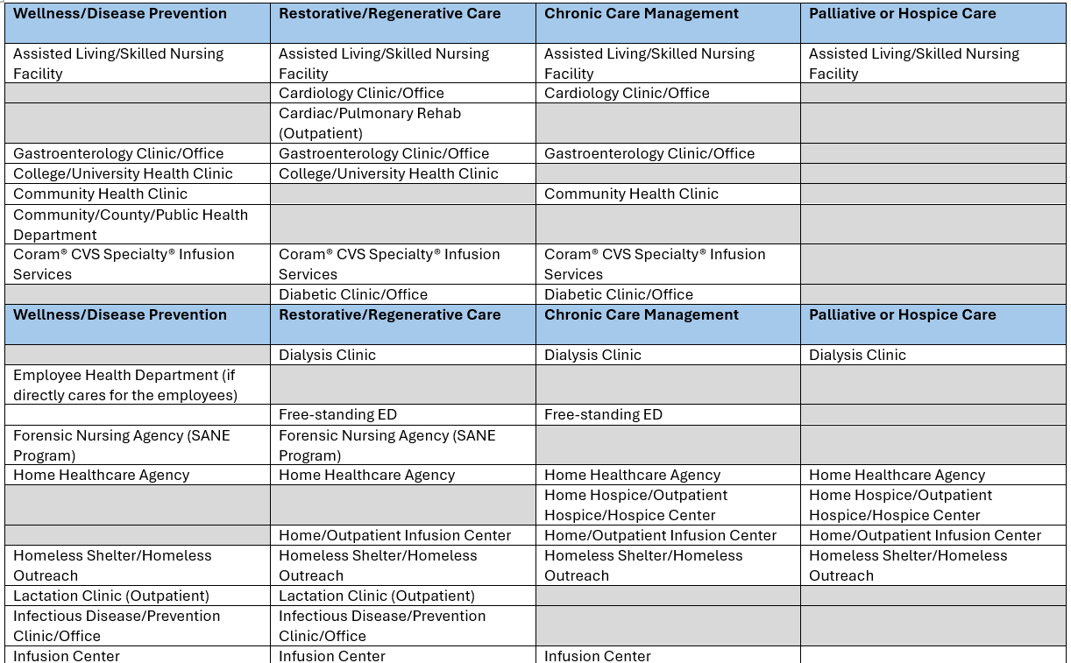
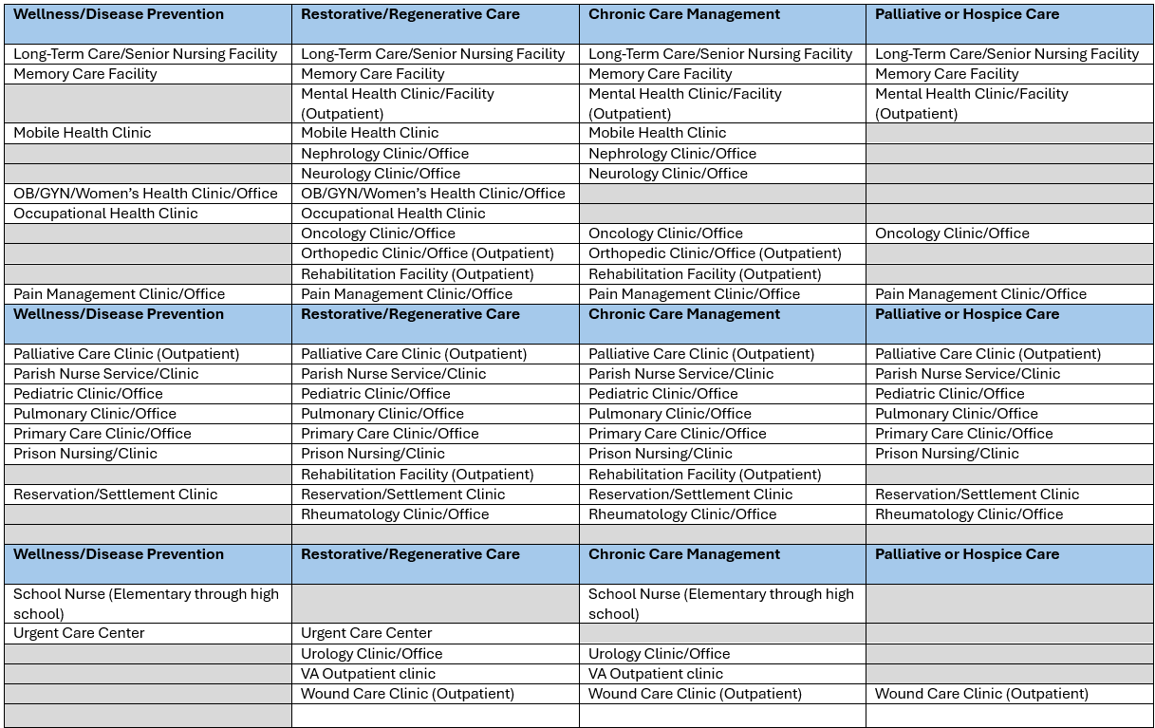
The recommendations outlined in this table reflect the common spheres of care typically associated with these clinical sites. Students are encouraged to verify the specific types of patient care available at their clinical site by consulting with their preceptor and instructor to ensure they align with field experience course requirements.
Appropriate Sites
Utilize this link to access a printable PDF of the
Appropriate Sites Based on Sphere of Care
Therapeutic Interventions

Slide 7
Field Experience
Spheres of Care
E224/L225
Therapeutic Interventions
Wellness/Disease Prevention
  identify a population at-risk for health issues from the community assessment and focus on the direct care to prevent these issues for the population such as patient assessment, education, planning.
Regenerative/Restorative-
  identify a population with current health issue/disease and focus upon care needs of this population by completing direct care hours such as patient assessment, education, planning, or communication.
Chronic Disease Management
  identify a population with a chronic disease and focus on direct care hours for health maintenance such as patient assessment, education, planning related to this population.
Palliative/Hospice Care
  identify a population with life-limiting or end-of-life issues and focus upon care needs to support or maintain quality of life by completing direct care hours such as patient assessment, education, planning, or communication with this population.

Slide 8
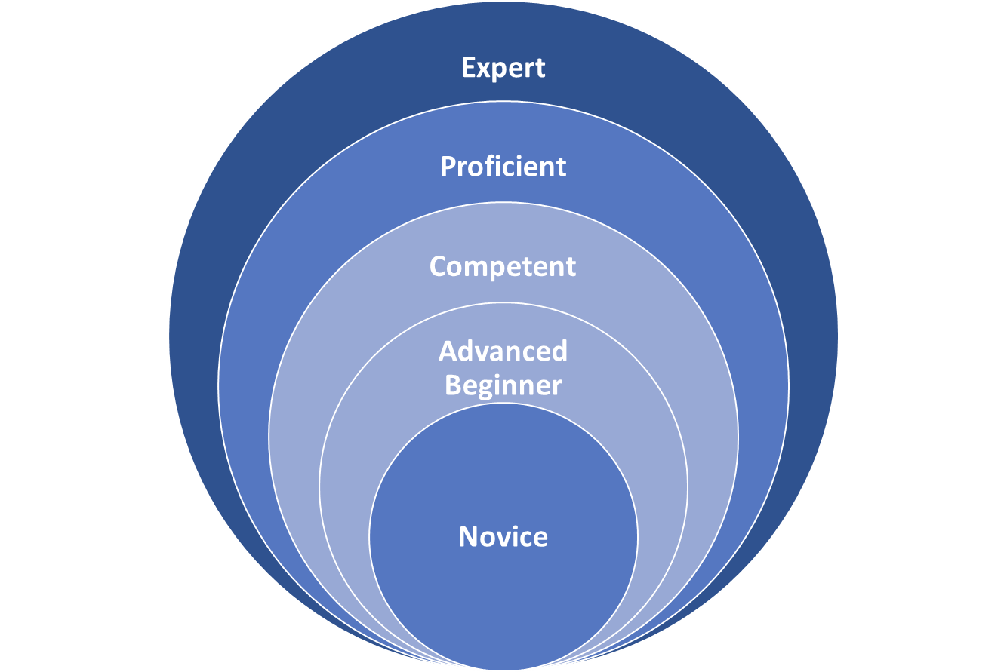
The clinical field experience allows you to grow with the help of your experienced nurse preceptor, that is at the proficient or expert level.
Progressing from Novice to Expert in the BSN Program
Therapeutic Interventions
Notes:
-

Slide 9
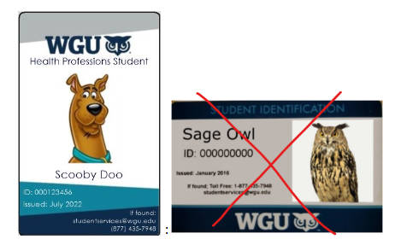
What is My Role when on Site for my Field Experience?
Professionally represent the Western Governors University Nursing Program.
Determine ahead of time appropriate professional attire for the setting while completing the FE.
When participating in Field Experience the student is required to wear a WGU Clinical Badge
Conduct practice without discrimination based on age, race, religion, nation of origin, sexual orientation, gender identification, or handicap.
Respect the dignity and rights of patients and/or students regardless of social or economic status.
Respect your BSN prepared nurse preceptor and accept supervision and guidance.
Seek out experiences that are appropriate to the field experience courses.
Therapeutic Interventions
The WGU Clinical Badge is not the same as the WGU Student ID. You will order the Clinical Badge through your Field Experience Page as one of the field experience requirements.

Slide 10

Preceptor Connection
Therapeutic Interventions
The WGU BSN Student identifies a nursing preceptor (only one preceptor) who can precept the student in a clinical site to support the field experience areas appropriate for the course.
As this is a volunteer (unpaid) positions, we do not have a list of preceptors for students to choose from.
Working with a self-identified preceptor ensures that you have a preceptor who is personally invested in your academic success.
Working with a self-identified preceptor ensures that the preceptor will be available at a time and geographic location most suitable to your needs.
Please note: All hours are to be completed outside of regular work hours. Anything related to your current work position (e.g., CPR training, work shifts, training orientation, or courses, classes, or conferences) are not acceptable for this project, nor are drive time, orientation, or other logistical or administrative tasks (e.g., obtaining a facility badge).

Slide 11

Preceptor Criteria
An appropriate preceptor will provide direct clinical experiences appropriate to the course to include:
Wellness/ Disease Prevention, Regenerative/Restorative Care, Hospice Palliative Care and Chronic Disease Management
The Preceptor:
Has an active unencumbered RN license
Must have a BSN or higher (MSN, NP, DNP) preferred
Must provide direct patient care in a community health setting
Has a minimum of 1 year experience in the field experience clinical area
Serves as a liaison/guide between the student, the clinical site/collaborative agencies
Has agreed to support a student’s learning to include:
  providing feedback on student participation in a supportive and constructive way
  communicate with the course instructor at the beginning, middle and end of the field experience
  timely approval (within 72 hours of notification from student) of the student’s time log to verify the accrued hours and account of the experience
Collaborates with the student and Course Instructor to recommend additional learning experiences consistent with the learning goals and course competencies
A nursing preceptor or an interdisciplinary preceptor shall not precept more than two students at any one time.
Therapeutic Interventions
*Preceptors cannot be a member of your immediate family, cannot be your direct supervisor, or have a financial, business, or professional relationship in conflict with the duties of preceptorship.*

Slide 12

Preceptor Identification
First, familiarize yourself with the role of the preceptor on the
BSNU Clinical Preceptor Page
  Know what you are asking your preceptor to do.
  When will you need them?
  How many hours will be involved?
  What kind of learning opportunities are needed?
  What credentials does the preceptor need to have?
Start networking to identify sites and preceptors aligned with your courses
Google appropriate clinical sites in your area and visit them in person.
Preceptors are more likely to agree to precept if you ask them in person vs. sending an email.
Only one RN to BSN prepared nurse preceptor can be used per course.
Therapeutic Interventions

Slide 13



Networking and Planning for Field Experience
Network in preparation of contact with the
Clinical Learning and Placement Support Team
regarding the Placement Process.
Network with personal and
professional contacts
Connecting with people and professionals in your circle is a great way to secure your placement with someone who is invested in your success.
Approaching Potential Sites in Person
Meeting face-to-face with potential sites and presenting a copy of your resume allows you to make a good first impression.
Approaching Potential Sites By Phone
Reaching out to sites by phone provides a great opportunity to introduce yourself, discuss your need for placement, and overall goals of your field experience.

Slide 14
Validating Field Experience Hours - E224/L225
**Time logs will not be available until you have received clearance from CLPS to begin.**
Submit field experience activities through the “Activity Log” link found on your Field Experience Page, by including the following:
Enter the start date and time for the day's field experience activity (Each day is logged separately).
Enter the end date and time for the day's field experience activity (Each day is logged separately)
Discuss specific details of the education, resources, services, collaboration, communication, etc. the NURSE provides while engaging with patients during this direct care experience that promotes the chosen sphere of care.
Select which sphere of care: Wellness, Disease Prevention, Regenerative/Restorative Health, Chronic Disease Management, Palliative/Hospice Care.
ONLY discuss the selected Sphere of Care: Describe the rationale (why) for the nursing interventions (education, resources, services, collaboration, communication, etc.) discussed above and how these work to achieve the chosen sphere of care.
NOTE: Hours completed as part of your regular work duties or within your normal work setting are not acceptable for this field experience. Field experience hours must be distinct, educational, and aligned with course objectives—not a continuation of your paid employment.
Therapeutic Interventions

Slide 15

Washington 3 Phone Calls
**WA State Specific Requirement**
Students who complete their Health Field Experience hours in the state of Washington must complete 3 scheduled phone calls between the Student, Preceptor, and WGU Instructor.
  These 3 phone calls will happen at the beginning, middle, and end of your field experience hours.
  Students are responsible for scheduling the calls.
  Student, Preceptor, and WGU Instructor must be present on all 3 calls.
Step 1.
Go to the course home page by clicking on the E224 Global and Population Health Course on your degree plan. On the right side of the course home page, you will see your assigned WGU Instructor. If you are not yet enrolled in this course, you will not see an assigned Instructor. You will need to wait to schedule this call once you have enrolled in the course and been assigned to a specific WGU Instructor.
Step 2.
Confirm with your Preceptor that they will be available to join a 15-minute call with you and your instructor.
Click on "Schedule an Appointment" found under the picture of your assigned Instructor.
Schedule a 15-minute appointment. You must verify that the time you select is the same time your Preceptor is available to join the scheduled call
Include your Preceptor’s Name and the reason for the appointment (WA Required Phone Call) in the “Purpose for the Appointment” box. This will allow your instructor to better prepare for the call.

Slide 16

Clinical Learning and Placement Support (CLPS)
Clinical Learning & Placement Support Department (CLPS)
Therapeutic Interventions

Slide 17
Click the graphics below to link to the PACED Video Series
Watch the “PACED”
Video Series
Please review each link to our video series, PACED!
Each video is 1-1 ½ minutes, and you’re welcome to watch them one at a time or all together in one sitting.
They can be viewed and re-viewed as often as needed.
Therapeutic Interventions
Video 1
Video 4
Video 5
Video 7
Overview of the clinical placement journey.
Introduction to the CLPS acronym PACED.
Preceptor and Placement Quick Tips.
Affiliation agreement and timelines.
WGU Standard Compliance/Immunizations
Essentials - Site-specifics and Onboarding.
Department Clearance Confirmation
Video 2
Video 6
Video 3
Click each graphic above to access one of the 7 videos associated with the steps of the Placement Process

Slide 18
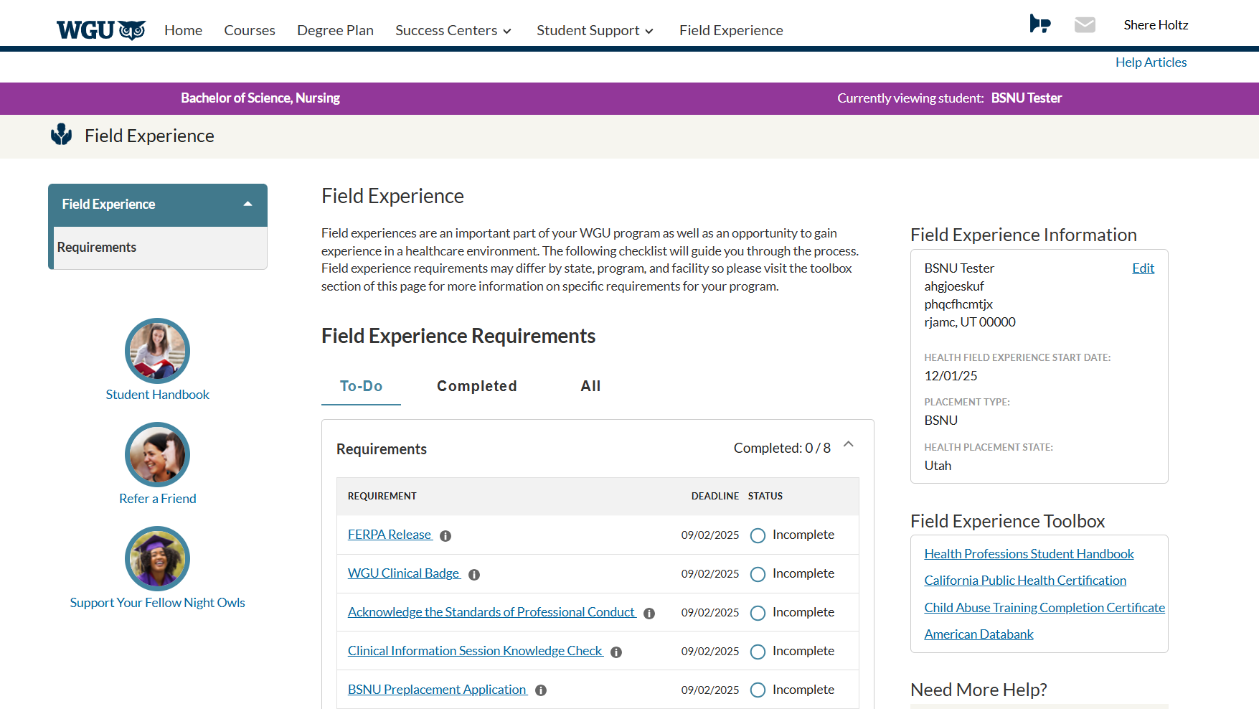
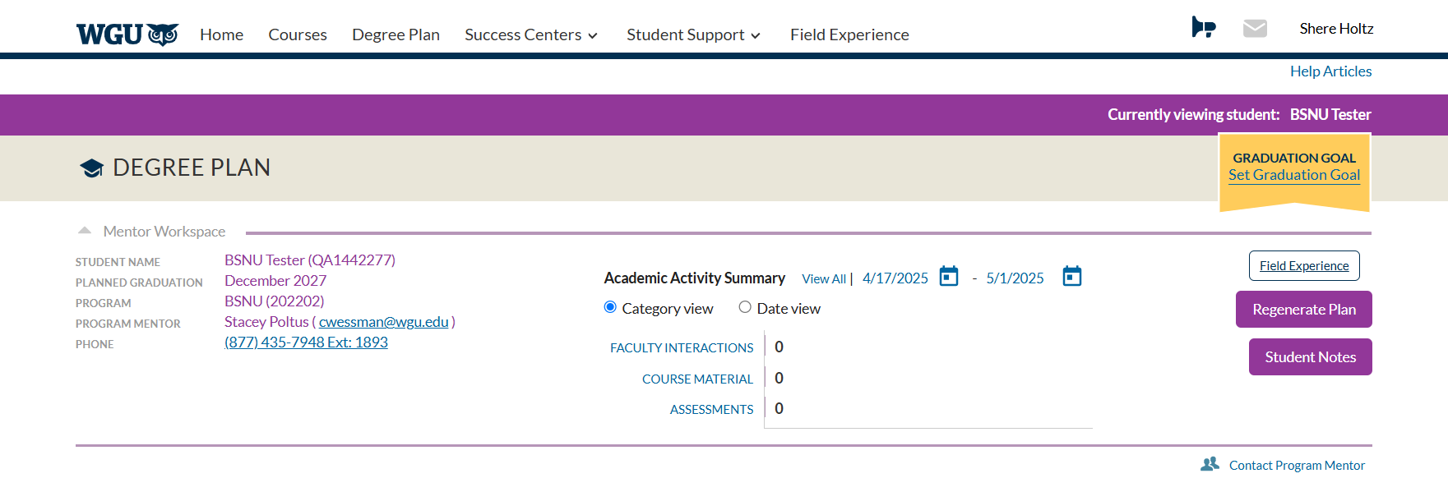
Accessing the Field
Experience Page
Student Facing Field Experience Page
You will access and complete the placement requirements within the student facing Field Experience Page.
You can access the page within your Student Portal on the "Field Experience" tab or within your Degree Plan by clicking the Field Experience Button.

Slide 19
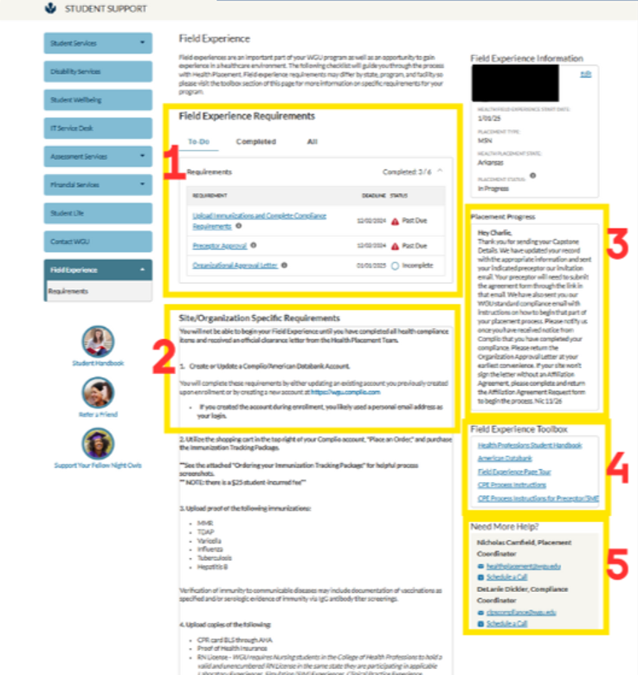
Field Experience Page
1. Field Experience Requirements
  Includes a checklist of tasks students must complete as part of the placement process.
  Tasks may vary depending on your specific program of study.
2. Site/Organization-Specific Requirements
  Details health and compliance requirements (e.g., immunizations, CPR certification) mandated by clinical sites.
  All items must be completed to receive clearance to begin your field experience.
3. Placement Progress
  Provides personalized updates on your placement status.
  Includes pending tasks, estimated timelines, and your next steps.
4. Field Experience Toolbox
  Offers quick access to handbooks, instructional guides, and helpful resources.
  Designed to support you throughout your placement journey.
5. Need More Help?
  Connect with your Placement or Compliance Coordinator for personalized support.
  Includes contact details and a link to schedule a support call
Therapeutic Interventions

Slide 20
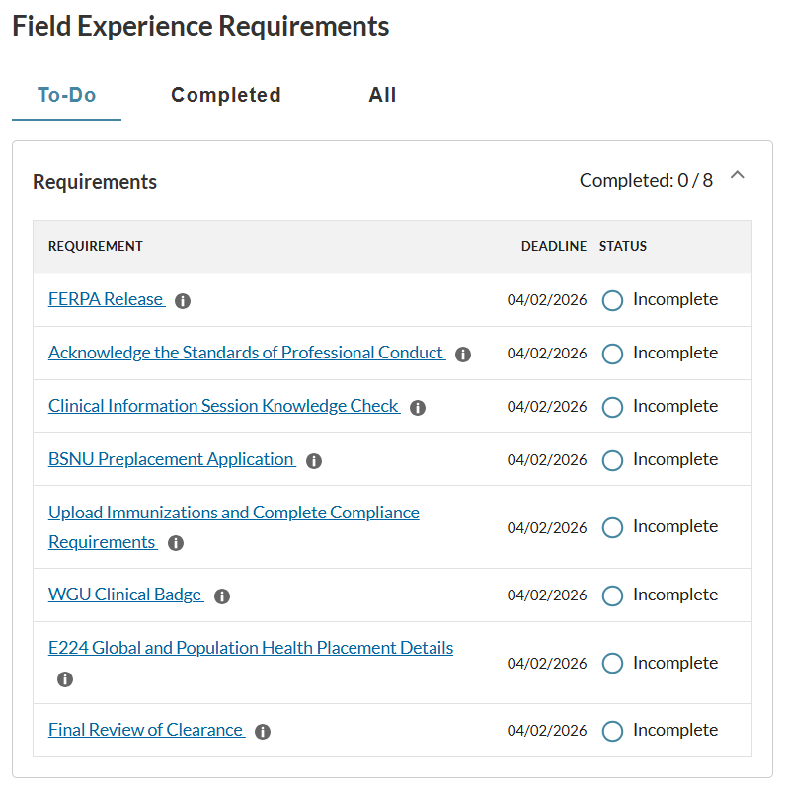
Field Experience Requirements
The Field Experience Page is a personalized resource containing field experience requirements and a checklist tailored to each WGU student.
This page serves as the primary platform for submitting required information for placement. Be sure to check it regularly for important updates.
Field Experience Page is also where you will find a link to submit your time logs once you are fully cleared, the field experience course is active in a current term, and you have clicked “start now” on the course.

Slide 21
Preplacement Preparation Tasks
Clinical Information Session
Knowledge Check
Preplacement Application
FERPA Release
Standards of Professional Conduct
Completing these early steps is essential for staying on track, avoiding unnecessary setbacks, and feeling confident as you transition into the clinical portion of your program.
It also gives the Clinical Learning and Placement Support (CLPS) team the essential information needed to initiate and support your placement journey. Early preparation establishes a strong foundation for both a successful clinical experience and ongoing professional advancement.

Slide 22

FERPA Release
The Family Educational Rights and Privacy Act of 1974 (FERPA) is a Federal law designed to protect the privacy of student education records.
Due to the FERPA laws, WGU may not give out your personal information without your written consent. Before we can begin working on your placement, which may require us to give out information to a site, we need you to fill out a Clinical FERPA Release
WGU's Compliance
  May require sharing information with a site or 3rd party onboarding platform
    FERPA Release Form Required
Placement Process
  Requires sharing information with a potential sites and/or Preceptors
    FERPA Release Form Required
❇️ Student Action Required
  Complete the FERPA Release Form
    Accessed from the Field Experience Page

Slide 23

Acknowledge Standards of
Professional Conduct
In keeping with the mission of Leavitt School of Health, students and graduates of WGU’s health programs are expected to have the needed proficiencies and to demonstrate the professional dispositions appropriate to the field of health.
You will read and acknowledge the standards of professional conduct. Submissions of your acknowledgement will satisfy this requirement.
❇️ Student Action Required
  Complete the Standards of Professional Conduct Acknowledgement Form
  Accessed from the Field Experience Page

Slide 24

Knowledge Check
Within 48 hours of reviewing the Clinical Information Session, you are expected to complete the Knowledge Check.
The Knowledge Check ensures you are familiar with your responsibilities in the placement process, including meeting important deadlines, submitting required immunizations, completing background checks, and providing other necessary documentation.
Completing the Knowledge Check promptly confirms you are prepared to move forward with placement and reinforces your understanding of how to stay on track. Taking action within this timeframe helps prevent delays, keeps you aligned with important milestones, and supports a smooth and successful transition into your clinical experience.
❇️ Student Action Required
  Complete the Knowledge Check
  Accessed from the Field Experience Page

Slide 25
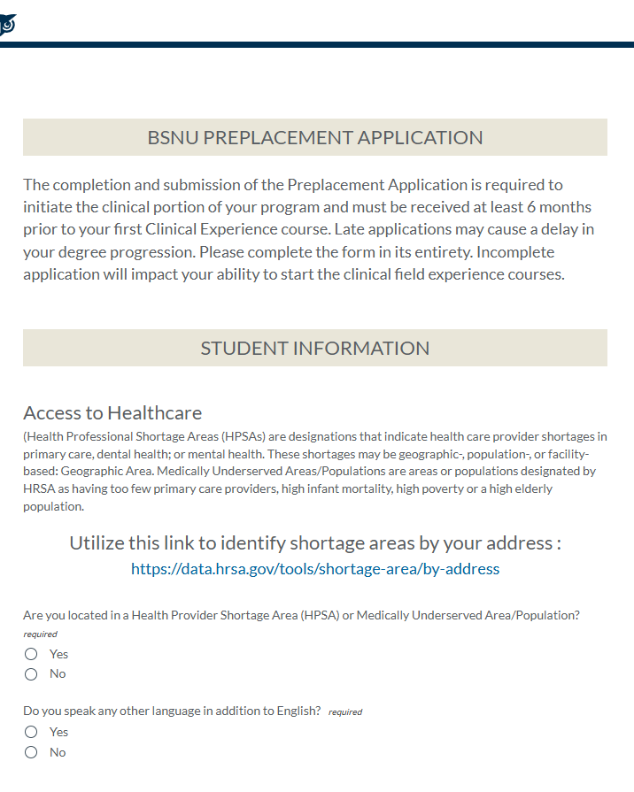
Preplacement Application
The BSNU Preplacement Application is a Student Profile, where you will provide the name of your current employer, indicate if you are in health professional shortage area, and provide emergency contact information.
The completion and submission of the BSNU Preplacement Application is required to initiate the clinical portion of your program and notifies our Clinical Learning and Placement Support Coordinators that you are ready to start the placement process.
❇️ Student Action Required
  Complete the BSNU Preplacement Application
  Accessed from the Field Experience Page

Slide 26

Schedule an Intro Call
with your assigned Placement Coordinator
Placement Introductory Call
The Introductory Call is a one-on-one meeting with your Placement Coordinator designed to support you in preparing for and navigating the clinical placement process.
Purpose of the Call:
Review your placement readiness tasks
Discuss your clinical preferences and eligibility
Clarify any questions about timelines, compliance, or site requirements
Offer guidance on how to strengthen your placement options
Ensure you understand your next steps and feel confident moving forward

Slide 27

WGU Standard Compliance
WGU Compliance Page
Access this page for instructions, documents, and forms related to WGU Standard Compliance
Standard Compliance for all BSNU Students is uploaded to ADB/Complio
Background Check - within the last 24 months
Vaccines (MMR, Tdap, Varicella, Flu, Hep B, and TB)
RN License - current and unencumbered RN license throughout the duration of their program. Students must be licensed in the state they are completing their PPE rotation.
Health Insurance - evidence of health insurance coverage throughout the Student’s clinical/field experience term(s).
CPR - current American Heart Association (AHA) Basic Life Support (BLS) CPR Certification
Therapeutic Interventions
Clinical Learning & Placement Support Compliance Team
clpscompliance@wgu.edu

Slide 28
Essentials/Site- Specifics
Depending on the Agreement that WGU has with your Clinical Site, there may be additional requirements for you to complete.
Clinical Learning and Placement Support will guide you through the steps required for placement at your chosen Clinical Site. Every site has different requirements, and requirements often change.
3rd Party onboarding
    ACEMAPP
    Castlebranch
    My Clinical Exchange
    San Diego Consortium
Site-Specific Documents and Forms :
    Confidentiality Agreements
    Compliance Attestations
    Institutional Review Board (IRB) Approvals
    Site Orientation and Badges
Please note that many of these requirements or third- party onboarding platforms have additional student fees associated with them.
Additional Requirements (as required by host site)
Updated Background Check
Third-Party Onboarding
Drug Screen
Physical Exam
Color-Blindness Test
Additional Immunizations
OSHA/HIPAA
Site Specific Documents & Forms
Therapeutic Interventions

Slide 29

WGU Clinical Badge
Order a WGU Clinical Badge within the Field Experience Page
Therapeutic Interventions
A WGU Clinical ID Badge provides proof of your student status and is required as part of your clinical placement.
After you submit the completed request form, your Clinical Badge will be mailed to the address provided. You can expect to receive your Clinical Badge within 20 business days.
Failure to order your Clinical Badge in a timely manner will delay receipt and can impact your ability to attend clinical field experience.

Slide 30



Placement Details Submission
Planning ahead leads to success!
Submit fully completed Placement Details at least 6 months before beginning your Clinical Field Experience.
Potential Clinical
Site Information
Required Information Includes:
Potential Clinical Site Legal Name
Potential Clinical Site Phone Number
Potential Clinical Site Physical Address
Potential Clinical Site Type
Contract Administrator
Contact Information
Required Information Includes:
Contract Administrator Name
Contract Administrator Phone Number
Contract Administrator Email Address
Contract Administrator Title
Potential Preceptor
Contact Information
Required Information Includes:
Potential Preceptor Name
Potential Preceptor Phone Number
Potential Preceptor Email Address
Potential Preceptors Credentials

Slide 31
To ensure a successful and compliant clinical experience, WGU’s Clinical Learning and Placement Support (CLPS) team collects specific placement information—including your preceptor’s contact information, contract administrator details,
and the site’s name and address – for several important reasons.
✅ What This Information Helps Us Do:
Obtain a Preceptor Acknowledgement Form to confirm your preceptor is qualified and appropriate to support your learning.
Verify an existing Affiliation Agreement or begin the process of negotiating a new contract with your host site.
Confirm the site’s placement process and identify any site-specific compliance requirements and onboarding procedures.
📌 Verification Requirements:
WGU must confirm that each placement meets course and accreditation requirements which includes:
a registered nurse preceptor with a bachelor’s degree or higher
an appropriate clinical site that offers sufficient direct patient care learning opportunities.
a focus on one or more of the following spheres of care: Wellness/Disease Prevention, Regenerative/Restorative Care, Chronic Disease Management or Palliative/Hospice care.
⚠️ We cannot process incomplete Placement Details! The only time you should submit placement details without a named preceptor, is if the site will be assigning a Preceptor as part of their standard process.

Slide 32

E224/L225 PRECEPTORS
Must review the WGU Preceptor Orientation Presentation
Must submit a Preceptor Acknowledgment Form
Will be verified to confirm they have an active license and meet accreditation standards
Will directly supervise and oversee all student activities throughout the field experience
Will provide constructive feedback
Will approve student time logs within the Preceptor Community.

Slide 33

Affiliation Agreements
What should I know about Clinical Sites
and Affiliation Agreements?
All BSNU placements require an Affiliation Agreement between WGU and the Clinical Site.
The negotiation of these agreements take time as they go back and forth several times before they are signed by both WGU and the Clinical Site.
📌 NOTE: This is a legal contract negotiation process and can take 4 to 6 months to fully execute. Plan accordingly to avoid delaying your degree progression.
Students will be notified by their Clinical Learning and Placement Support Coordinator of any additional site-specific requirements once the agreement has been fully executed and approved for student placement.
Therapeutic Interventions

Slide 34
CLPS Department Clearance
NOTE: Review times will vary depending on the requirements and timeframe of your Clinical Site.
After a placement is confirmed to meet all accreditation, compliance, and site-specific requirements you’ll receive an official “Clearance Confirmation Email”.
Clearance Confirmation Email = CLPS Department Clearance
Sent from: clpsbsnu@wgu.edu.
Recipients: Student, Preceptor, and Mentor.
This email officially clears you to begin your Field Experience once you field experience is in your current term and you are actively enrolled in the course.
Before students can be cleared, a final review of each placement is completed to ensure it meets accreditation requirements including a registered nurse preceptor with a bachelor’s degree or higher at an appropriate clinical site that offers sufficient direct patient care learning opportunities.
Each clinical site is reviewed to confirm there is an active affiliation agreement and to ensure we meet all contractual obligation including the collection and processing of all site-specific compliance, placement documents, and any additional onboarding with your host site or through a 3rd party vendor.
Therapeutic Interventions
Students cannot engage in hours prior to receiving the Clearance Confirmation Email from their
Clinical Learning and Placement Support Coordinator.

Slide 35
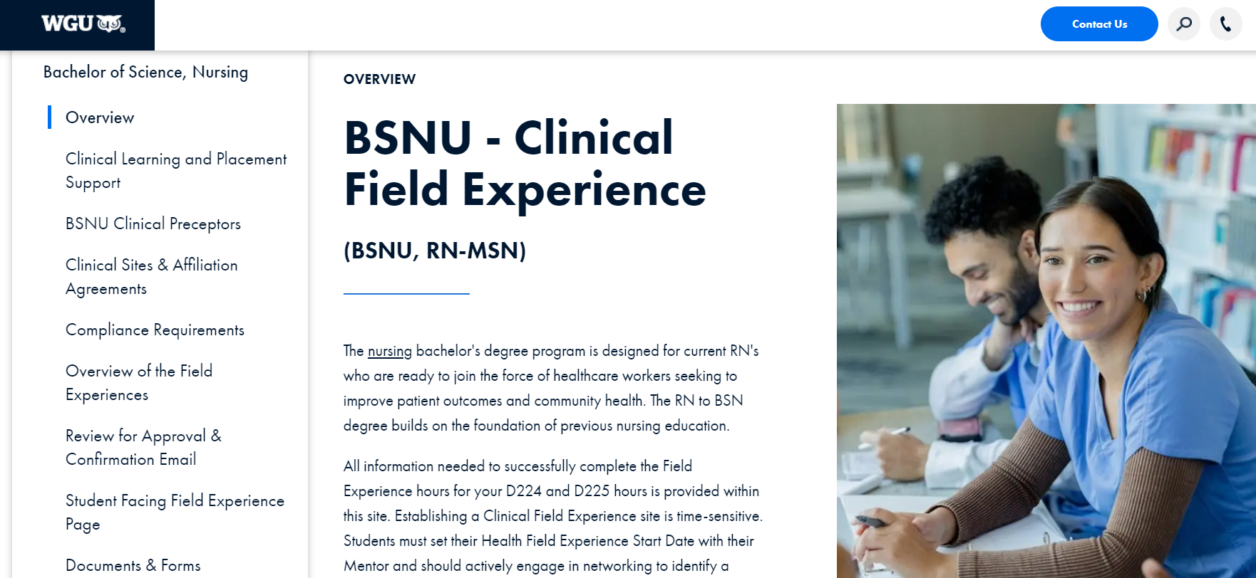
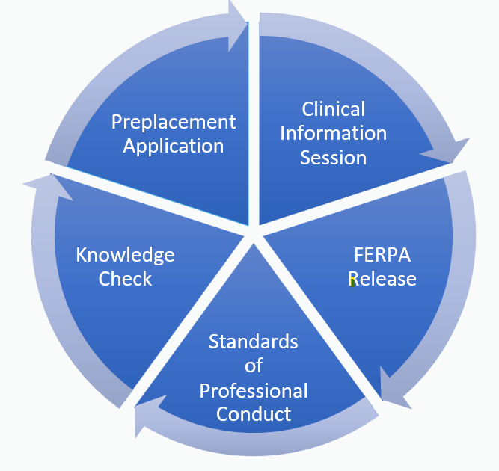
Next Steps
Taking the time now to complete these tasks helps ensure a smoother placement process and sets you up for success during your clinical field experience.
Access the Clinical Field Experience
Landing Page
Review Site & Preceptor Requirements
Access your Field Experience Page and begin
Working through your Requirements
Complete Preplacement Activities

Slide 36

Questions
For questions regarding Appropriateness of Sites and Activities
please contact the course instructors for the associated course:
E224 – E224PopHealth@wgu.edu
L225 – L225PopPractice@wgu.edu
For questions about the Placement Process, Affiliation Agreements, and Clearance
please contact clpsbsnu@wgu.edu
For questions related to WGU Standard Compliance
please contact clpscompliance@wgu.edu
ADB/Complio related issues – please contact ADB/Complio at (800) 200-0853

Slide 37

This checklist represents the sequential Field Experience process that you, the student, will complete once you have been cleared by WGU’s Clinical Learning and Placement Support Team (CLPS)
Once you are Cleared to Begin
Course Requirements | Core
Receive Clearance Confirmation email from CLPS | ✓
Enroll in a Course with a Field Experience | ✓
Faculty of Record Identified | ✓
Submit Activity Logs | ✓
Obtain Approval of activities from your BSN Prepared Nurse | ✓
Completion of Field Experience hours verified by Faculty | ✓
Competent Pass Earned | ✓
Therapeutic Interventions

